Slide 1
Practice： Design MapReduce Algorithms
Counting total enrollments of two specified courses
Input Files: A list of students with their enrolled courses
Jamie: COMP9313, COMP9318
Tom: COMP9331, COMP9313
… …
Mapper selects records and outputs initial counts
Input: Key – student, value – a list of courses
Output: (COMP9313, 1), (COMP9318, 1), …
Reducer accumulates counts
Input: (COMP9313, [1, 1, …]), (COMP9318, [1, 1, …])
Output: (COMP9313, 16), (COMP9318, 35)

Slide 2
Practice： Design MapReduce Algorithms
Remove duplicate records
Input: a list of records
2013-11-01 aa 2013-11-02 bb 2013-11-03 cc 2013-11-01 aa 2013-11-03 dd
Mapper
Input (record_id, record)
Output (record, “”)
E.g., (2013-11-01 aa, “”), (2013-11-02 bb, “”), …
Reducer
Input (record, [“”, “”, “”, …])
E.g., (2013-11-01 aa, [“”, “”]), (2013-11-02 bb, [“”]), …
Output (record, “”)

Slide 3
Practice： Design MapReduce Algorithms
Assume that in an online shopping system, a huge log file stores the information of each transaction. Each line of the log is in format of “userID\t product\t price\t time”. Your task is to use MapReduce to find out the top-5 expensive products purchased by each user in 2016
Mapper:
Input(transaction_id, transaction)
initialize an associate array H(UserID, priority queue Q of log record based on price)
map(): get local top-5 for each user
cleanup(): emit the entries in H
Reducer:
Input(userID, list of queues[])
get top-5 products from the list of queues

Slide 4
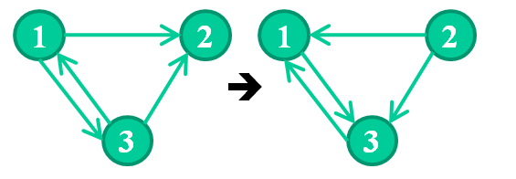
Practice： Design MapReduce Algorithms
Reverse graph edge directions & output in node order
Input: adjacency list of graph (3 nodes and 4 edges)
(3, [1, 2]) (1, [3])
(1, [2, 3]) ➔ (2, [1, 3])
(3, [1])
Note, the node_ids in the output values are also sorted. But Hadoop only sorts on keys!
Solutions: Secondary sort

Slide 5
Practice： Design MapReduce Algorithms
Map
Input: (3, [1, 2]), (1, [2, 3]).
Intermediate: (1, [3]), (2, [3]), (2, [1]), (3, [1]). (reverse direction)
Output: (<1, 3>, [3]), (<2, 3>, [3]), (<2, 1>, [1]), (<3, 1>, [1]).
Copy node_ids from value to key.
Partition on Key.field1, and Sort on whole Key (both fields)
Input: (<1, 3>, [3]), (<2, 3>, [3]), (<2, 1>, [1]), (<3, 1>, [1])
Output: (<1, 3>, [3]), (<2, 1>, [1]), (<2, 3>, [3]), (<3, 1>, [1])
Grouping comparator
Merge according to part of the key
Output: (<1, 3>, [3]), (<2, 1>, [1, 3]), (<3, 1>, [1]) this will be the reducer’s input
Reducer
Merge according to part of the key
Output: (1, [3]), (2, [1, 3]), (3, [1])

Slide 6
Practice： Design MapReduce Algorithms
Calculate the common friends for each pair of users in Facebook. Assume the friends are stored in format of Person->[List of Friends], e.g.: A -> [B C D], B -> [A C D E], C -> [A B D E], D -> [A B C E], E -> [B C D]. Your result should be like:
(A B) -> (C D)
(A C) -> (B D)
(A D) -> (B C)
(B C) -> (A D E)
(B D) -> (A C E)
(B E) -> (C D)
(C D) -> (A B E)
(C E) -> (B D)
(D E) -> (B C)

Slide 7
Practice： Design MapReduce Algorithms
Mapper:
Input(user u, List of Friends [f₁, f₂, …,])
map(): for each friend f_{i}, emit (<u, f_{i}>, List of Friends [f₁, f₂, …,])
Reducer:
Input(user u, list of friends lists[])
Get the intersection from all friends lists
Example: http://stevekrenzel.com/articles/finding-friends

Slide 8
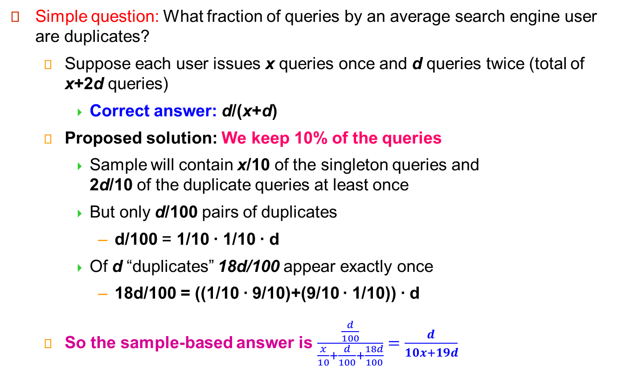
Problem with Naïve Approach
Simple question: What fraction of queries by an average search engine user are duplicates?
Suppose each user issues x queries once and d queries twice (total of x+2d queries)
Correct answer: d/(x+d)
Proposed solution: We keep 10% of the queries
Sample will contain x/10 of the singleton queries and 2d/10 of the duplicate queries at least once
But only d/100 pairs of duplicates
d/100 = 1/10 ∙ 1/10 ∙ d
Of d “duplicates” 18d/100 appear exactly once
18d/100 = ((1/10 ∙ 9/10)+(9/10 ∙ 1/10)) ∙ d
So the sample-based answer is $\frac{\frac{d}{100}}{\frac{x}{10}+\frac{d}{100}+\frac{18d}{100}}=\frac{d}{10x+19d}$
≠d/(x+d)
Notes:
d/100 appear twitece: 1st query gets sampled with prob. 1/10, 2nd also with 1/10, there are d such queries: d/100
18d/100 appear once. 1/10 for first to get selection and 9/10 for the second to not get selected. And the other way around so 18d/100

Slide 9
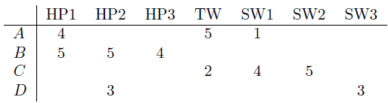
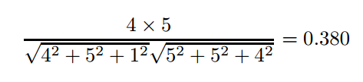
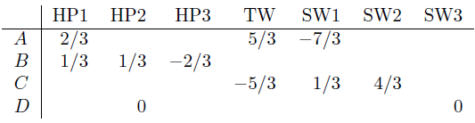
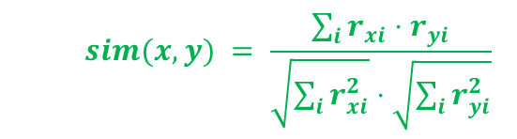
Similarity Metric
Cosine similarity:
$$sim(x, y) = \frac{\sum_{i}{r_{xi}⋅r_{yi}}}{\sqrt{\sum_{i}{r_{xi}^{2}}}⋅\sqrt{\sum_{i}{r_{yi}^{2}}}}$$
Intuitively we want: sim(A, B) > sim(A, C)
Jaccard similarity: 1/5 < 2/4
Cosine similarity: 0.380 > 0.322
Considers missing ratings as “negative”
Solution: subtract the (row) mean
sim A,B vs. A,C:
0.092 > -0.559
Notice cosine sim. is correlation when data is centered at 0
Notes:
4,5,1 这些数字在算jaccard时候无意义, 1/5是因为AB一共占五列,其中第一列相同
2/3这个是减每一行的mean

Slide 10
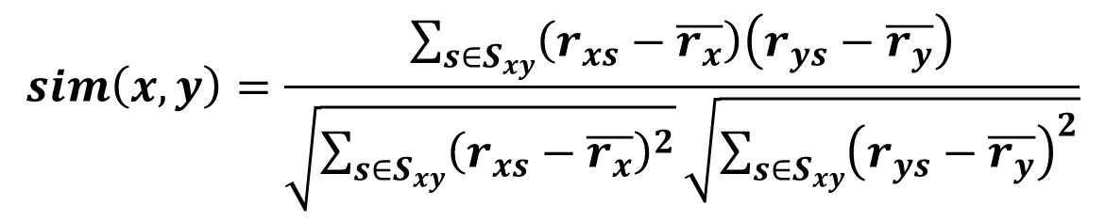
Similarity Metric (Cont’)
A popular similarity measure in user-based CF: Pearson correlation
Possible similarity values between -1 and 1;
$$sim\left(x,y\right)=\frac{\sum_{s∈S_{xy}}{\left(r_{xs}−\overline{r_{x}}\right)\left(r_{ys}−\overline{r_{y}}\right)}}{\sqrt{\sum_{s∈S_{xy}}{{\left(r_{xs}−\overline{r_{x}}\right)}^{2}}}\sqrt{\sum_{s∈S_{xy}}{{\left(r_{ys}−\overline{r_{y}}\right)}^{2}}}}$$
 | Item1 | Item2 | Item3 | Item4 | Item5
Alice | 5 | 3 | 4 | 4 | ?
User1 | 3 | 1 | 2 | 3 | 3
User2 | 4 | 3 | 4 | 3 | 5
User3 | 3 | 3 | 1 | 5 | 4
User4 | 1 | 5 | 5 | 2 | 1
sim = 0,85
sim = 0,70
sim = -0,79
Notes:
Alice 和user1, 取前四列推sim

Slide 11
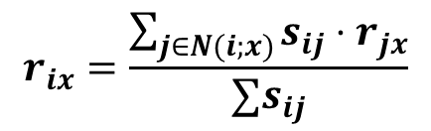
Item-Item CF (|N|=2)
users
12 | 11 | 10 | 9 | 8 | 7 | 6 | 5 | 4 | 3 | 2 | 1
 | 4 |  | 5 |  |  | 5 | ? |  | 3 |  | 1 | 1
3 | 1 | 2 |  |  | 4 |  |  | 4 | 5 |  |  | 2
 | 5 | 3 | 4 |  | 3 |  | 2 | 1 |  | 4 | 2 | 3
 | 2 |  |  | 4 |  |  | 5 |  | 4 | 2 |  | 4
5 | 2 |  |  |  |  | 2 | 4 | 3 | 4 |  |  | 5
 | 4 |  |  | 2 |  |  | 3 |  | 3 |  | 1 | 6
sim(1,m)
1.00
-0.18
0.41
-0.10
-0.31
0.59
movies
$$r_{ix}=\frac{\sum_{j∈N(i;x)}{s_{ij}⋅r_{jx}}}{∑s_{ij}}$$
Neighbor selection: Identify movies similar to movie 1, rated by user 5
Here we use Pearson correlation as similarity:
1) Subtract mean rating m_{i} from each movie i m₁ = (1+3+5+5+4)/5 = 3.6 row 1: [-2.6, 0, -0.6, 0, 0, 1.4, 0, 0, 1.4, 0, 0.4, 0]
2) Compute cosine similarities between rows
Notes:
s_{1,3}=0.41, s_{1,6}=0.59 => r_{1.5} = (0.41*2 + 0.59*3) / (0.41+0.59) = 2.6 用正相关的movie in user5的值推1的值

Slide 12
